Slide 1



STRUCTURED LIGHT ASSISTED REAL-TIME STEREO PHOTOGRAMMETRY FOR ROBOTICS AND AUTOMATION
Novel implementation of stereo matching

Slide 2
PROBLEM STATEMENT
01
Building of dense and accurate disparity map for correct depth estimation of a scene
Standard based algorithm
Deep learning based algorithm
Accurate in multiple situations but generally slow
Generally fast but suffer from domain shift problem
Our algorithm
Based on standard strategy but exploit initial information for accelerating the process

Slide 3
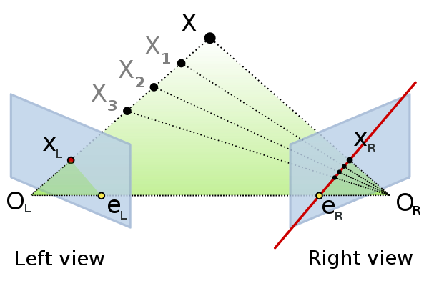

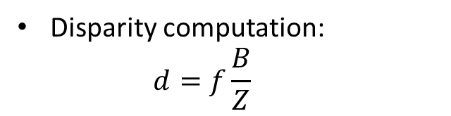

THEORETICAL BACKGROUND
EPIPOLAR GEOMETRY
02
Estimation of a disparity map is focused on the concept of epipolar geometry
Pixel correspondence:
$$0=x_{R}^{T}·l_{R}=x_{R}^{T} F x_{L}$$
Rectification:
$$H^{−T }·l_{L}=H^{′−T}·l_{R}$$
Disparity computation:
$$d=f\frac{B}{Z}$$

Slide 4
THEORETICAL BACKGROUND
STEREO MATCHING METHODS
03
Standard stereo matching algorithms
Deep learning based algorithms
Generic pipeline of these methods:
Matching cost computation
Cost aggregation
Disparity computation
Disparity refinement
Most of the current state-of-the-art implementations are based on this approach
In general:
Main pipeline based on standard methods → local or global
Parameters are finely tuned exploiting a Convolutional Neural Network (CNN)
Two main families:
Local or area-based algorithms
Global methods

Slide 5
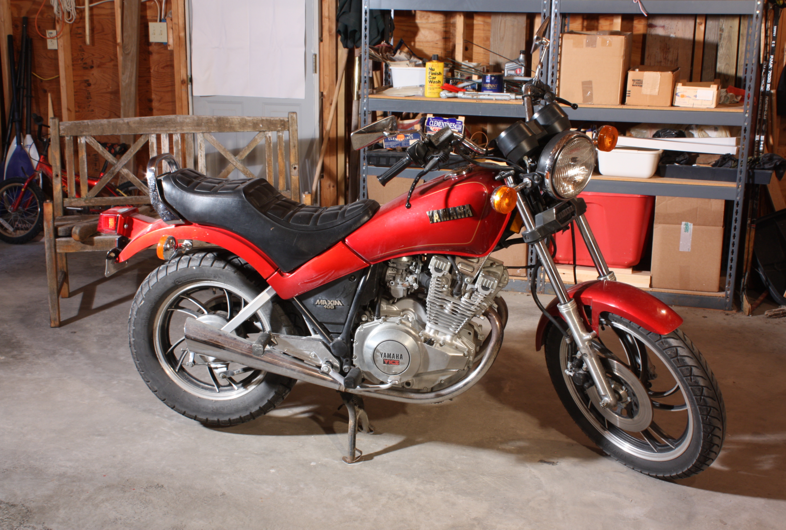
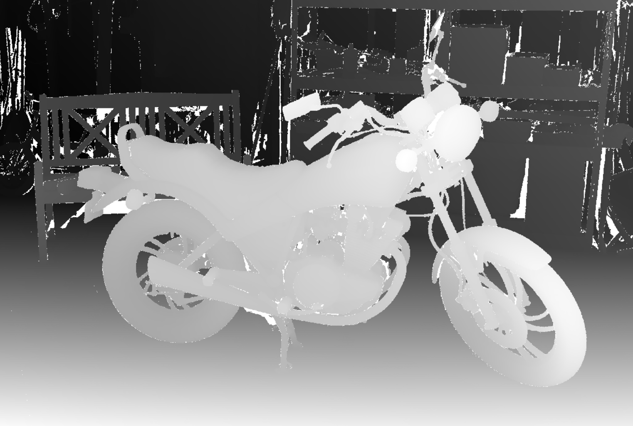
HARDWARE AND SOFTWARE ENVIRONMENT
MIDDLEBURY DATASET
04
High resolution stereo dataset comprises static indoor scenes and including highly detailed ground-truth disparities
Specifications:
33 indoor 6 megapixel dataset
Accuracy in disparity estimation of 0.2 pixels on most of the surfaces
Employed for initial testing phase of the designed algorithm
Chosen with respect to KITTI dataset for the higher accuracy of the disparity data

Slide 6
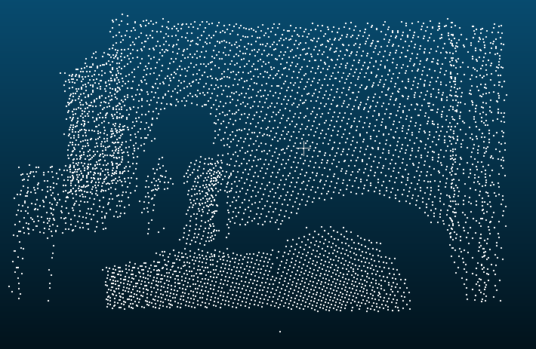
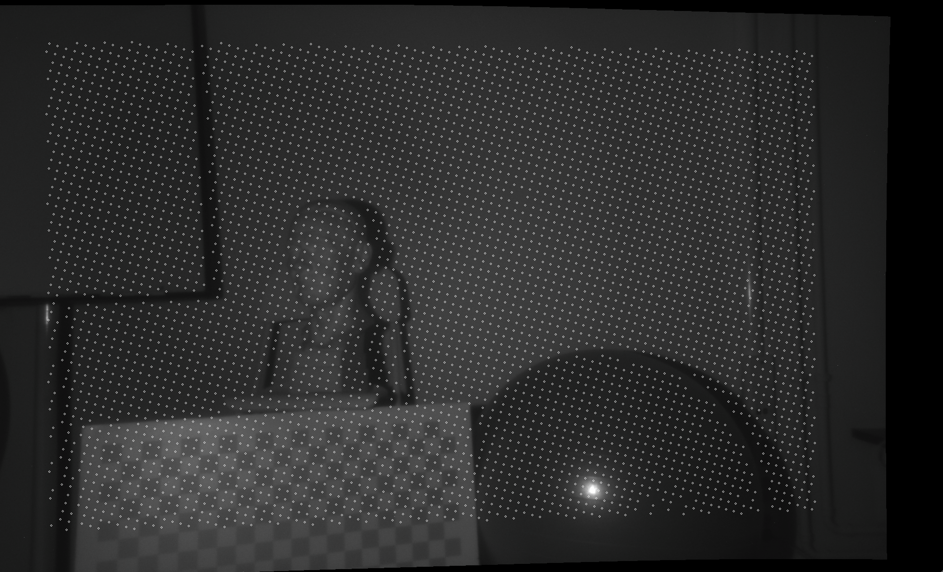
HARDWARE AND SOFTWARE ENVIRONMENT
LADIMO DEVICE AND IMAGES
05
Two types of LaDiMo device employed
micro device
Less accurate but compact
It can guarantee, in general, a good accuracy of the final result and it can be embedded in more complex systems, such as mobile robots or robotic arms
4-eye device
More accurate but bigger footprint
High accuracy of the results
Can be attached to robust systems that need highly detailed results

Slide 7
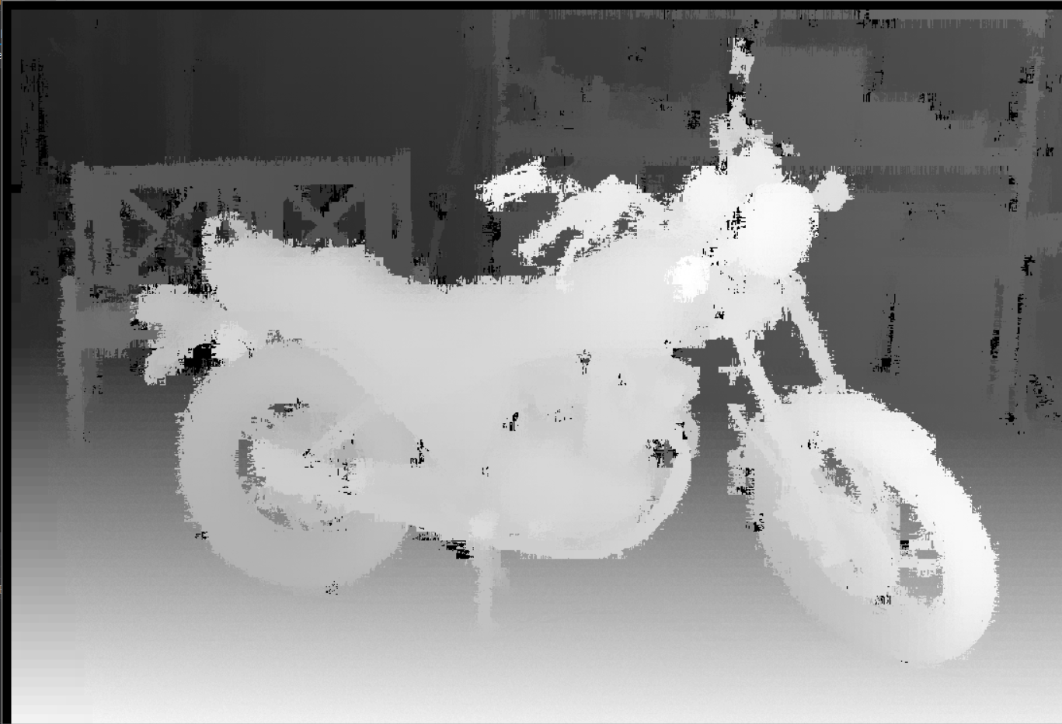
METHODS AND IMPLEMENATION
SGM BASED ALGORITHM
06
One of the two designed algorithms
Strongly related to the standard implementation of the Hirschmüller Semi-Global Matching (SGM) method
Main differences:
Generally non continuous disparity levels
Information from the initial point cloud are employed for the estimations of the final dense cloud

Slide 8
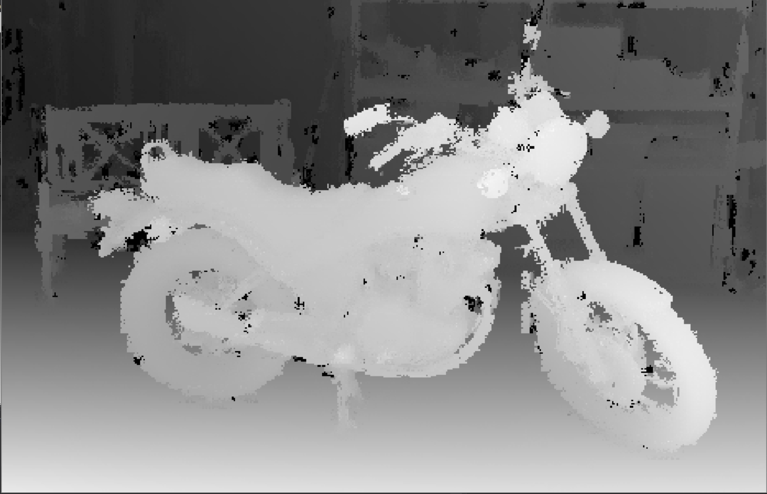
METHODS AND IMPLEMENATION
DERIVATIVE BASED ALGORITHM
07
Second of the designed algorithm
Extremely faster than the SGM-based approach
In comparison it ensures a good accuracy at a relatively low computational cost
It strongly exploits the information coming from the initial point cloud
Implementation is based on the local derivatives among the points of the initial cloud

Slide 9
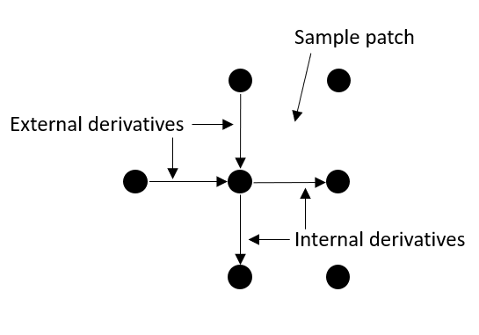
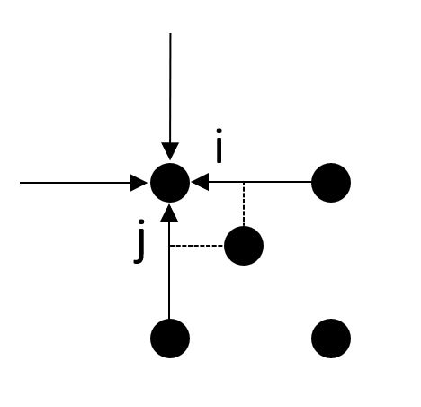
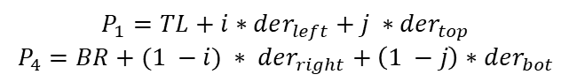
METHODS AND IMPLEMENATION
DERIVATIVE BASED ALGORITHM
08
Main idea of the derivative based method
Initial grid defined by LaDiMo points is densified exploiting entirely the estimations of the internal and external derivatives relative to each one of the points
Equations below are examples of how the first step of the estimation is computed
$$P_{1}=TL+i∗der_{left}+j ∗der_{top}$$
$$P_{4}=BR+(1 −i) ∗ der_{right}+\left(1 −j\right)∗der_{bot}$$

Slide 10
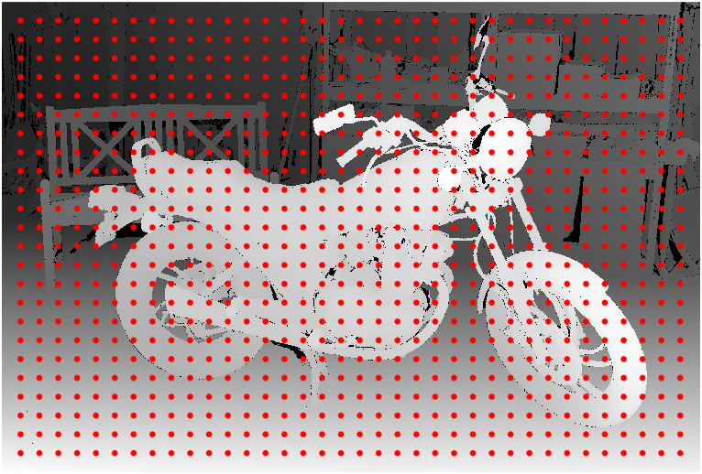
METHODS AND IMPLEMENATION
RESEARCHING PHASE ON MATLAB
09
Initial researching phase developed in MATLAB
Simulated initial grid of point generated over the Middlebury ground-truth images, thus to mimic the real grid produced by the LaDiMo device
This procedure is aimed at obtaining initial outcomes relatively to the feasibility of the thought strategy

Slide 11
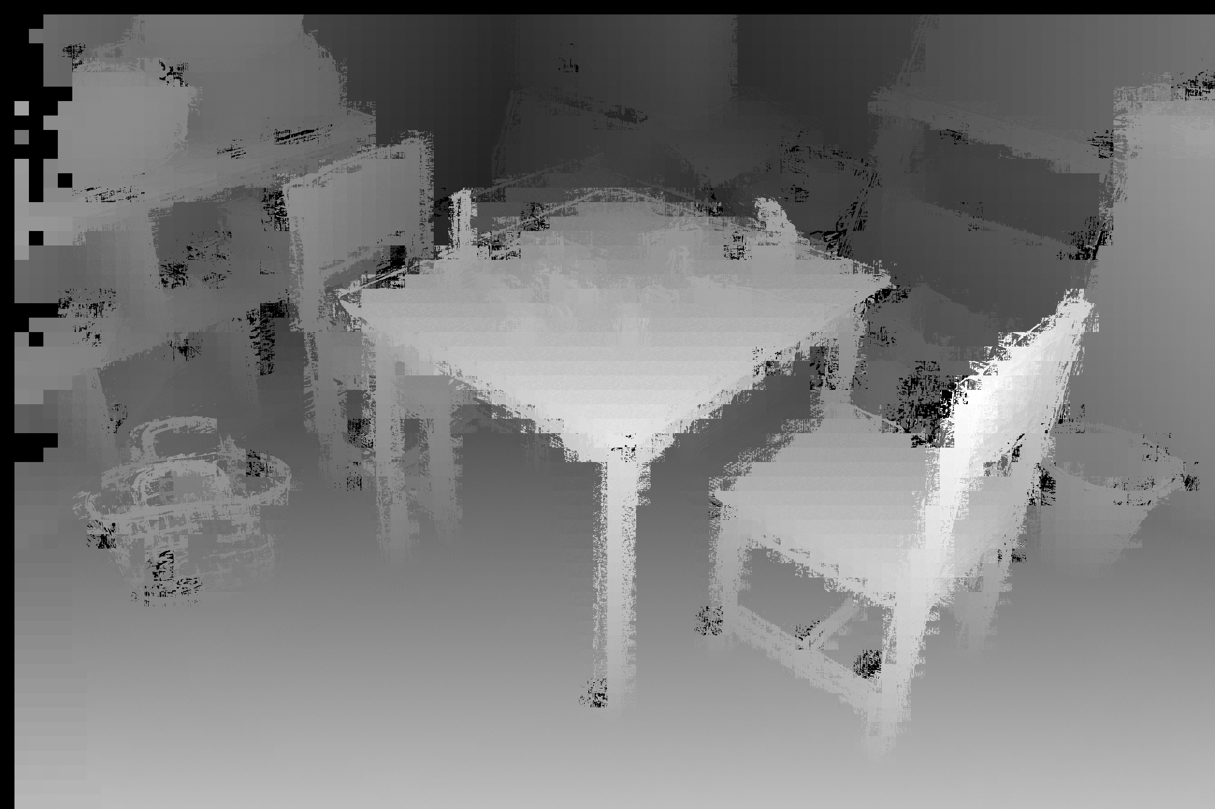
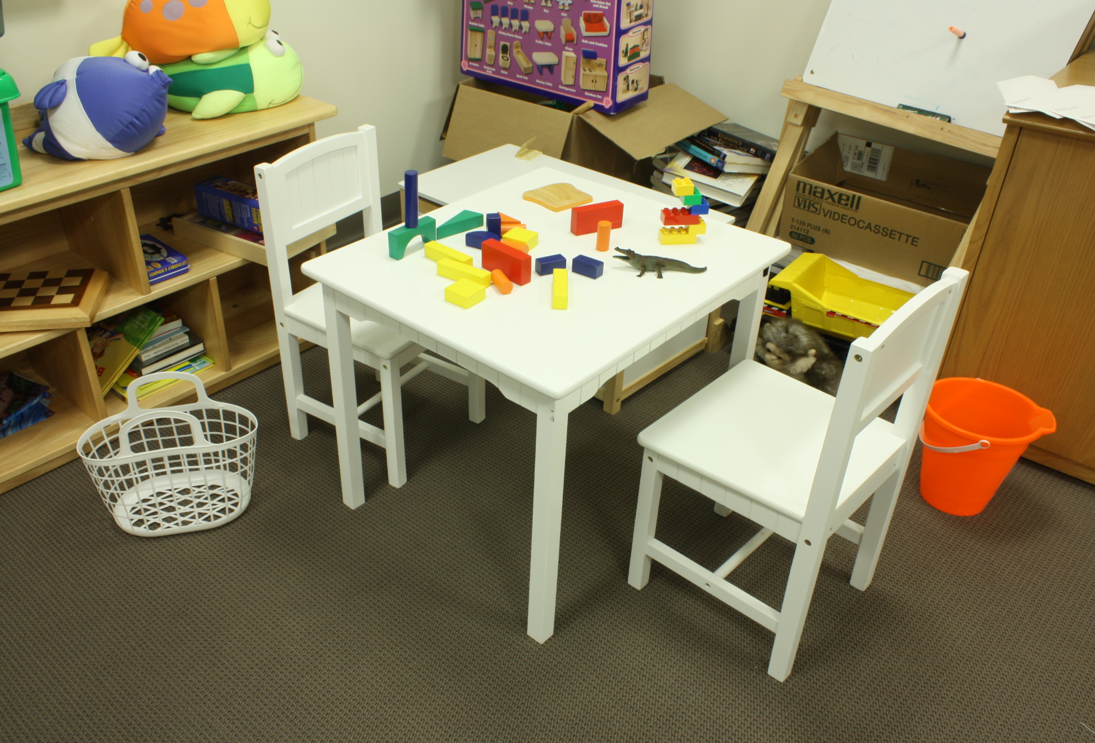
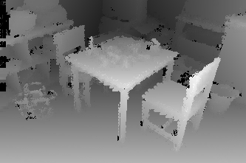
METHODS AND IMPLEMENATION
RESEARCHING PHASE ON MATLAB
10

Slide 12
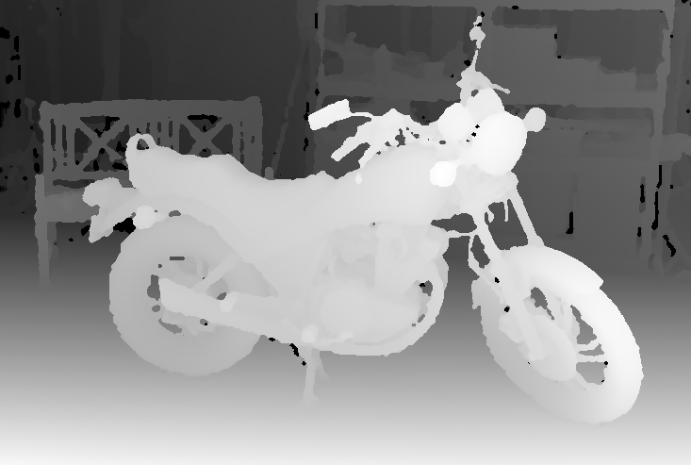
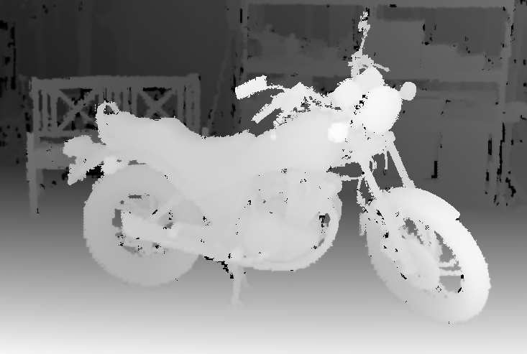
METHODS AND IMPLEMENATION
IMPLEMENTATION ON DATABASE IMAGES
11
Median filtered disparity map
Bilateral filtered disparity map

Slide 13
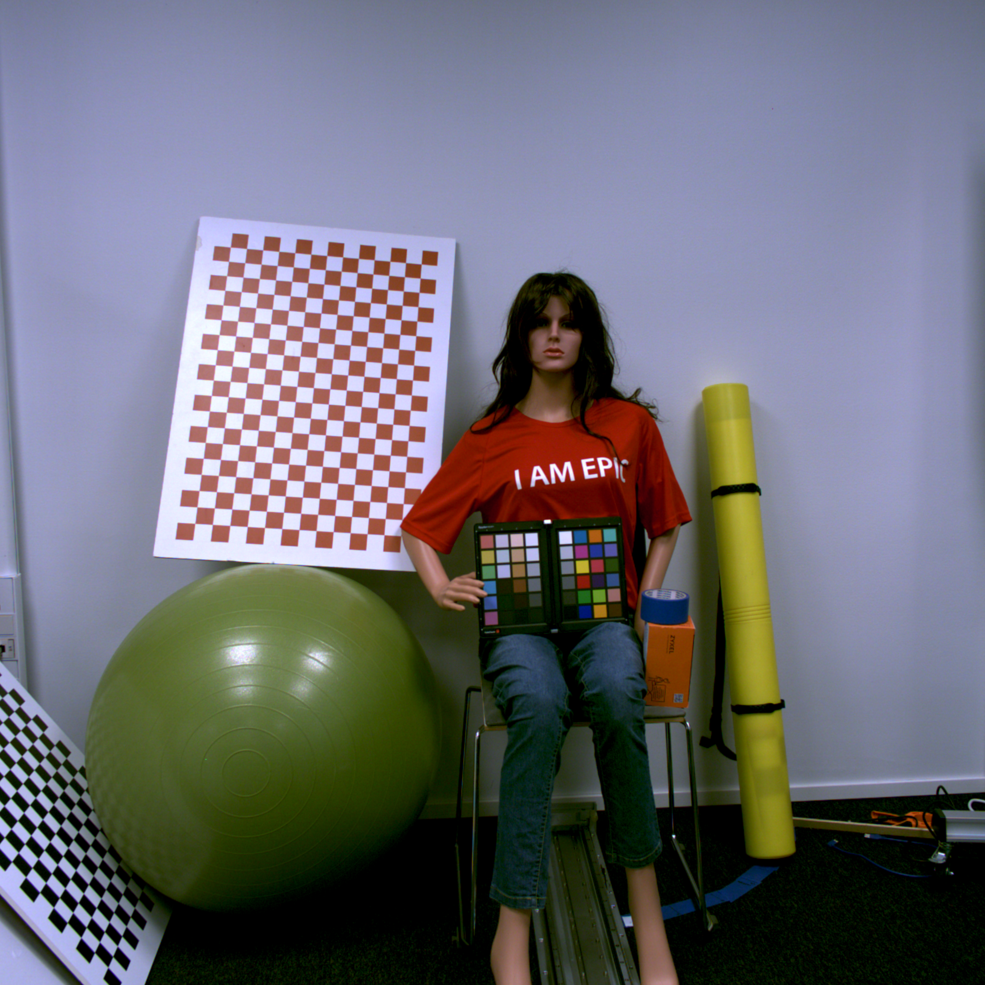
METHODS AND IMPLEMENATION
IMPLEMENTATION ON REAL IMAGES
12
Left initial RGB rectified stereo image obtained with 4-eye device
Left initial rectified stereo image obtained with micro device

Slide 14
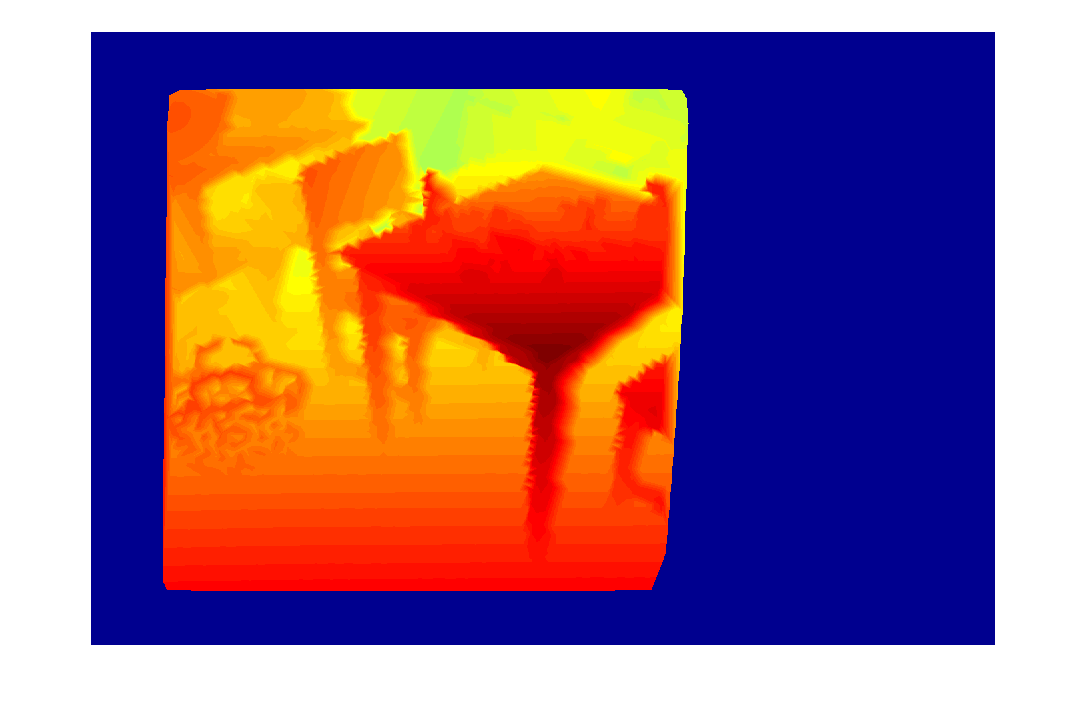
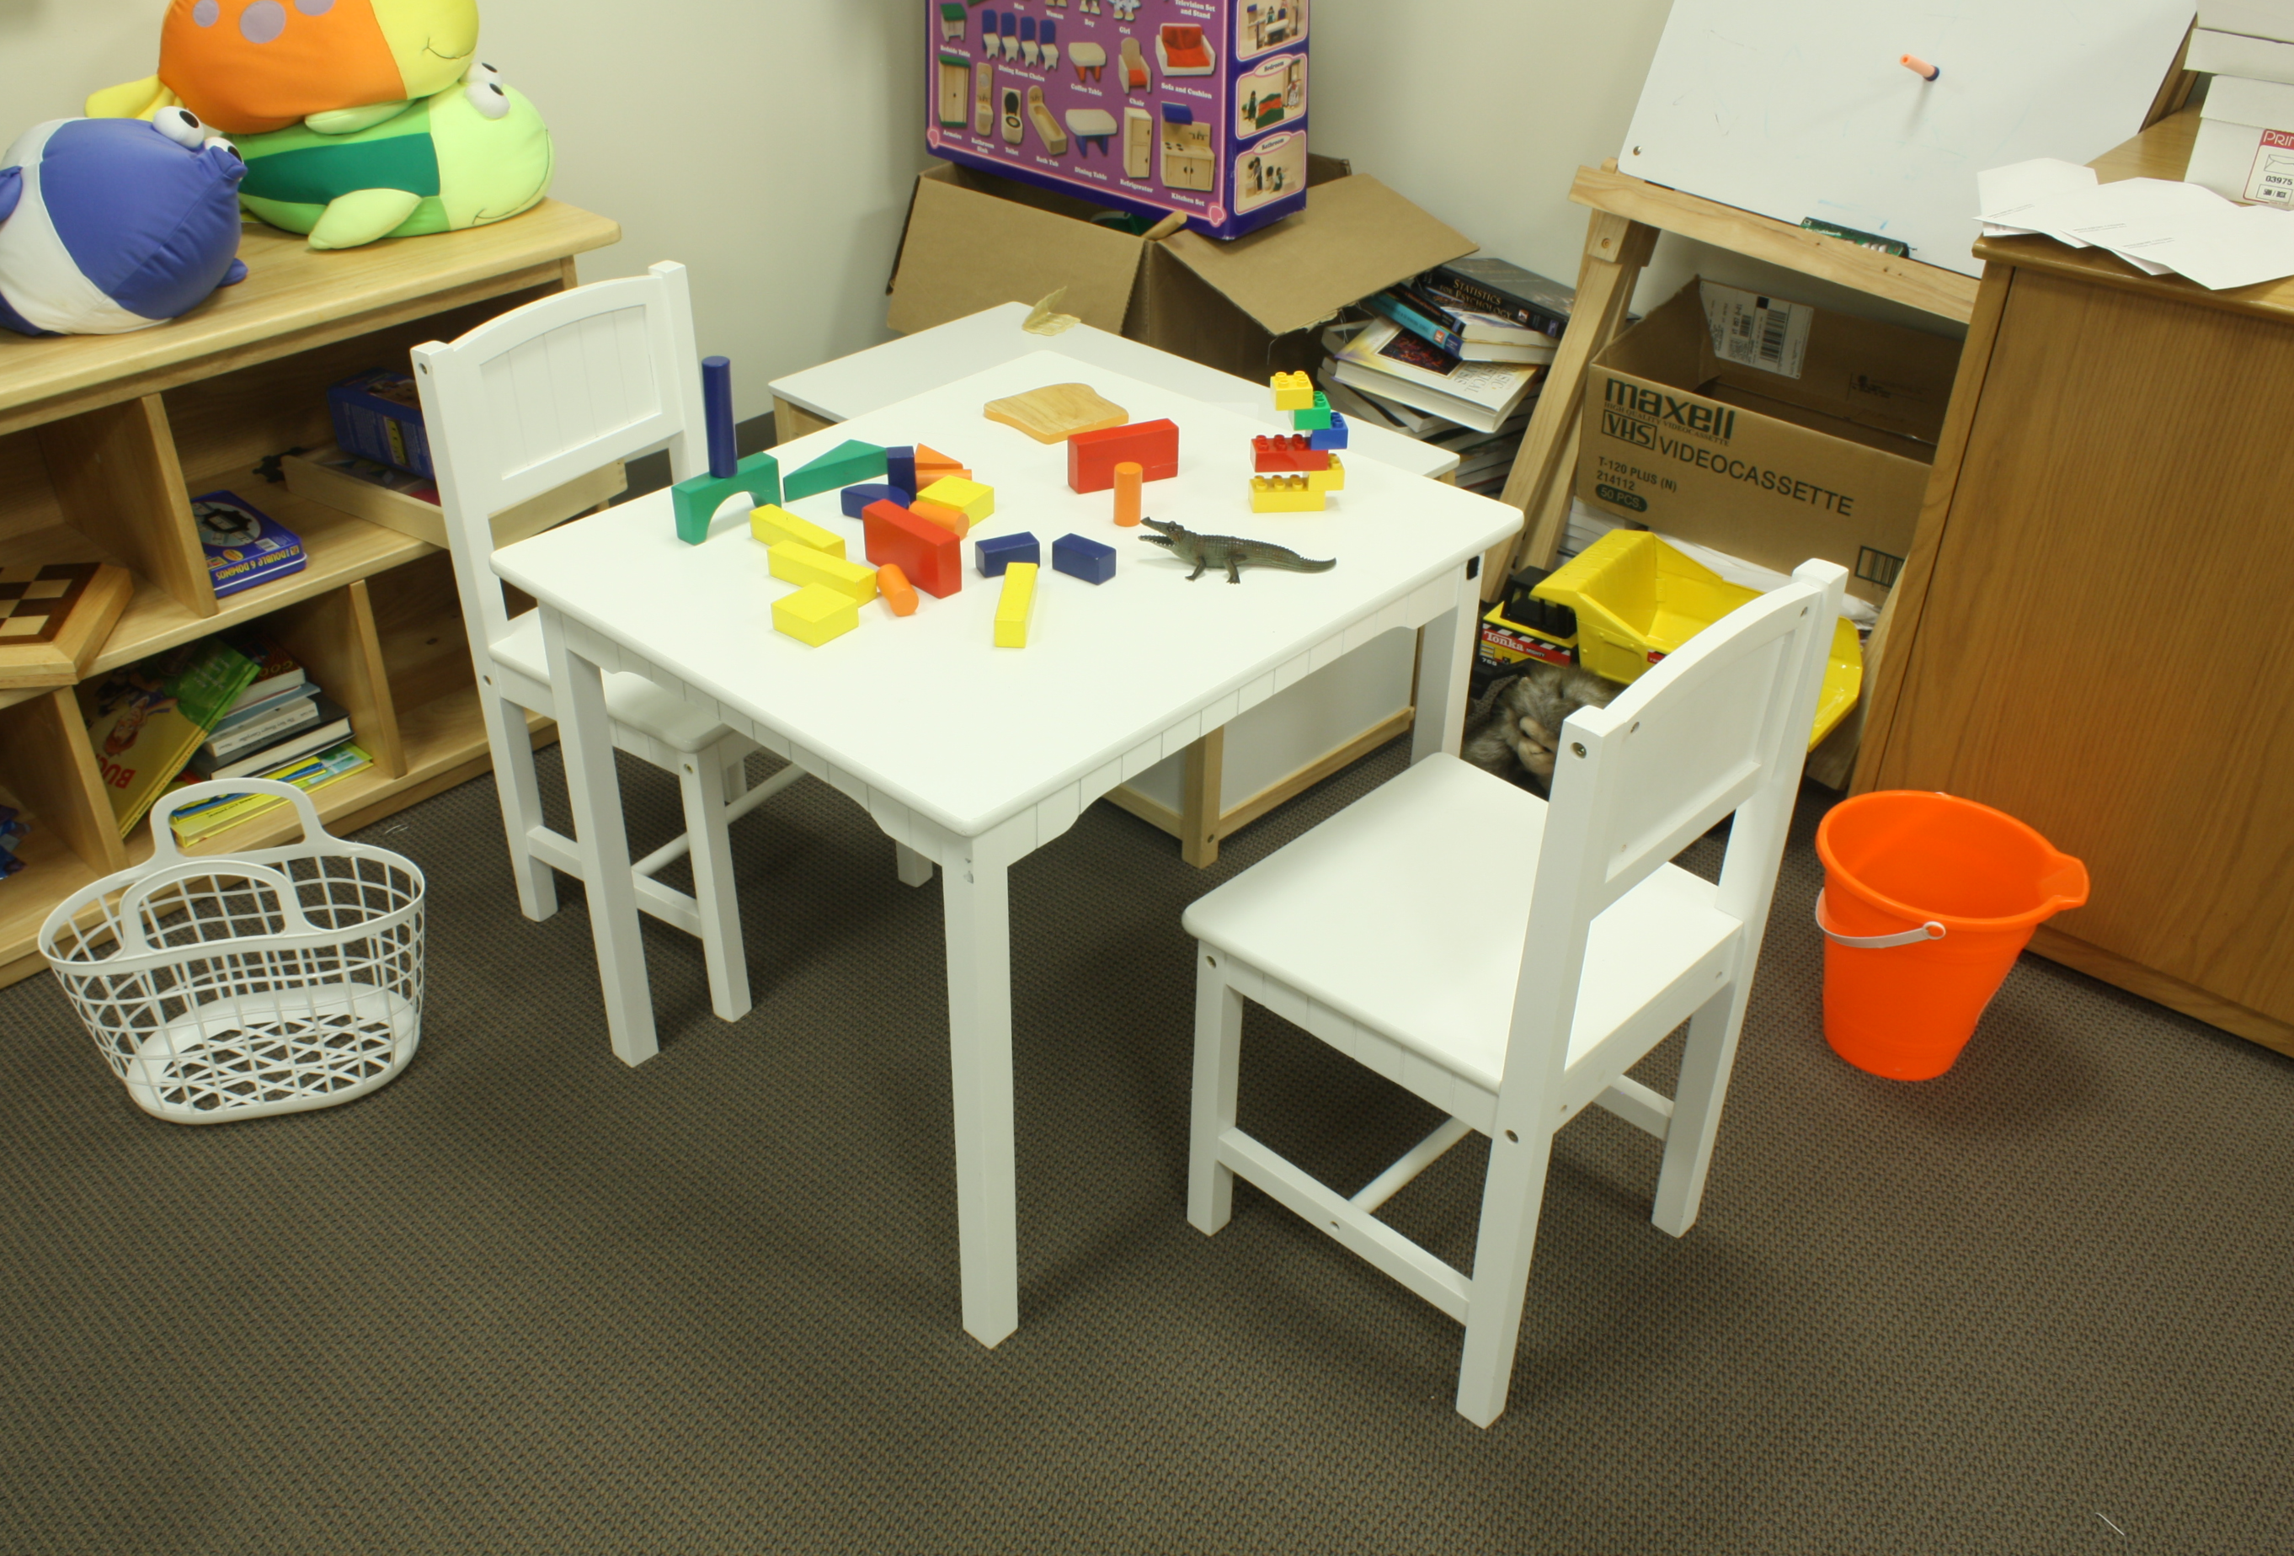
RESULTS AND DISCUSSION
RESEARCHING PHASE RESULTS
13
Results obtained in MATLAB
Generated implementing a simple version of the SGM algorithm and using information from a simulated grid of point
Result not perfect but feasibility of the strategy proven

Slide 15
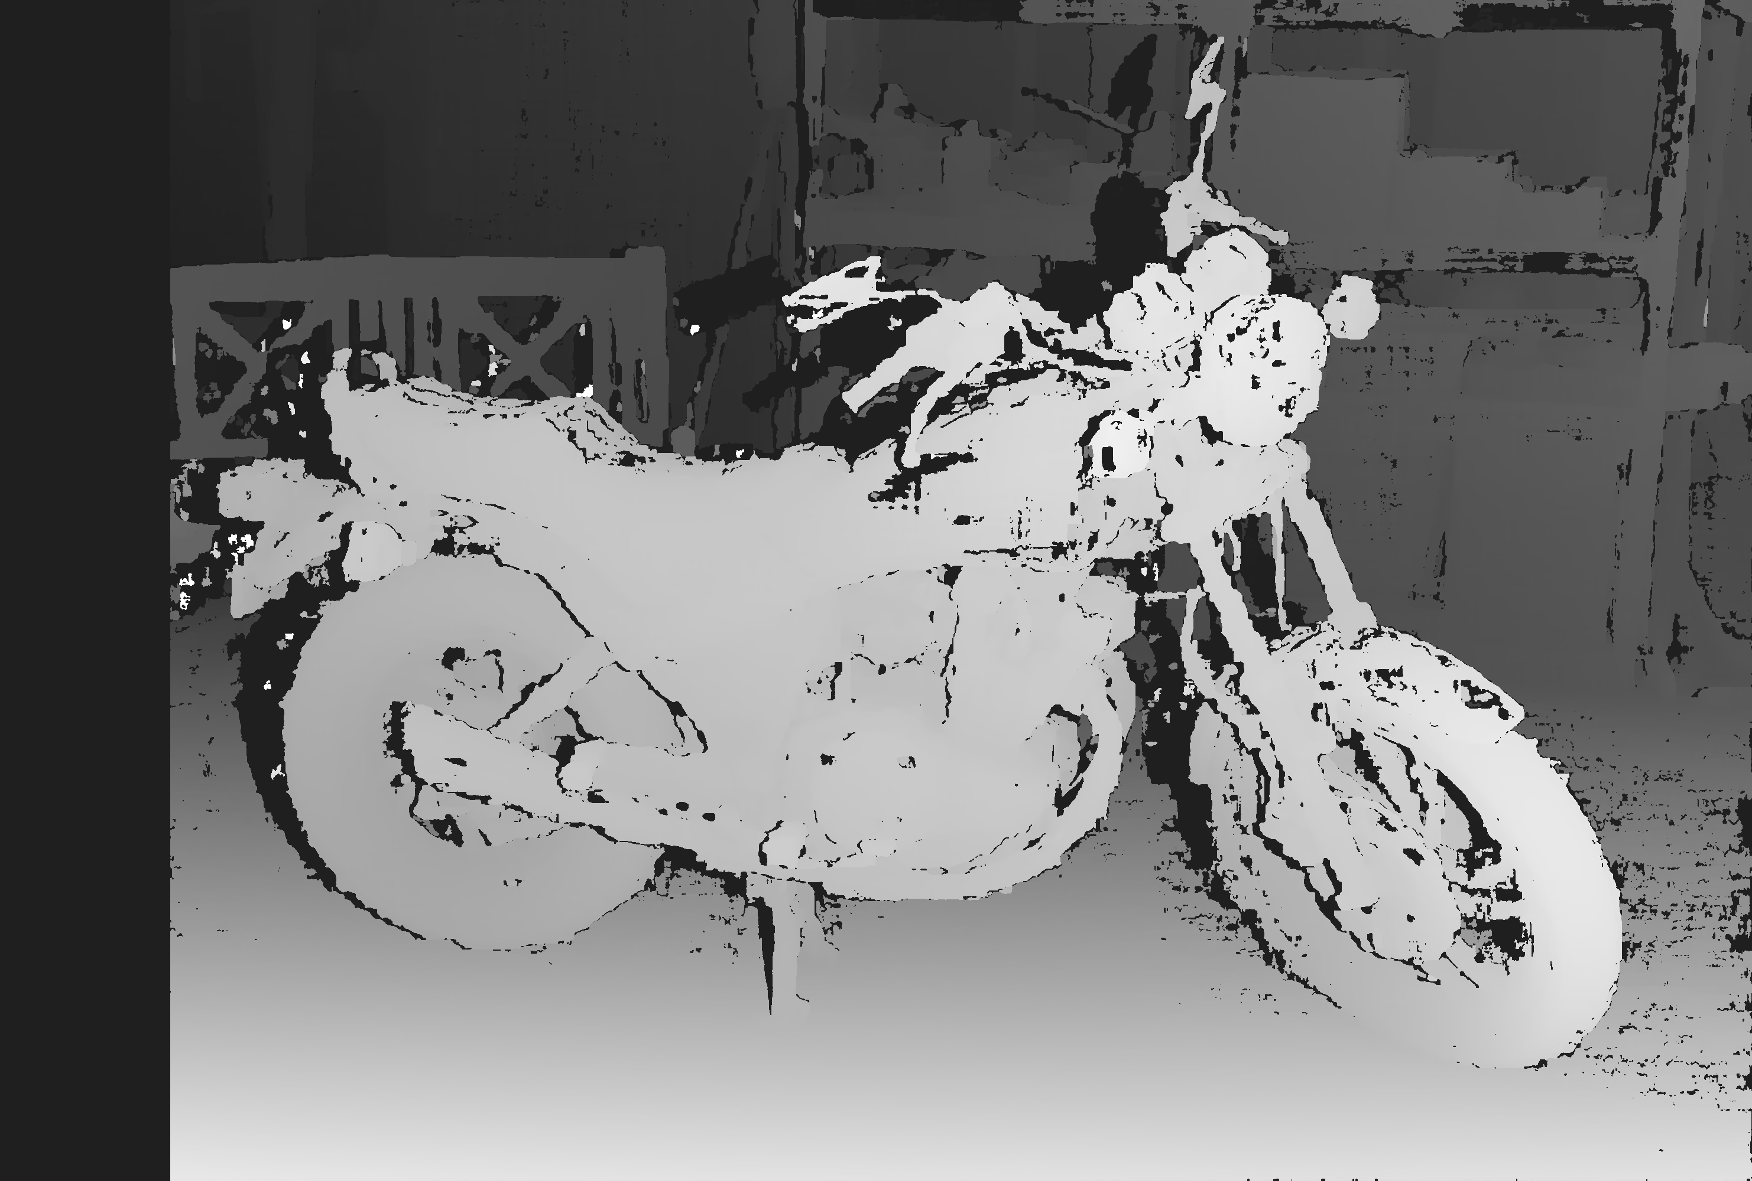
RESULTS AND DISCUSSION
OPENCV BASELINE RESULTS
14
Disparity result obtained applying OpenCV built-in method stereoSGBM()
Ground truth image from Middlebury dataset

Slide 16
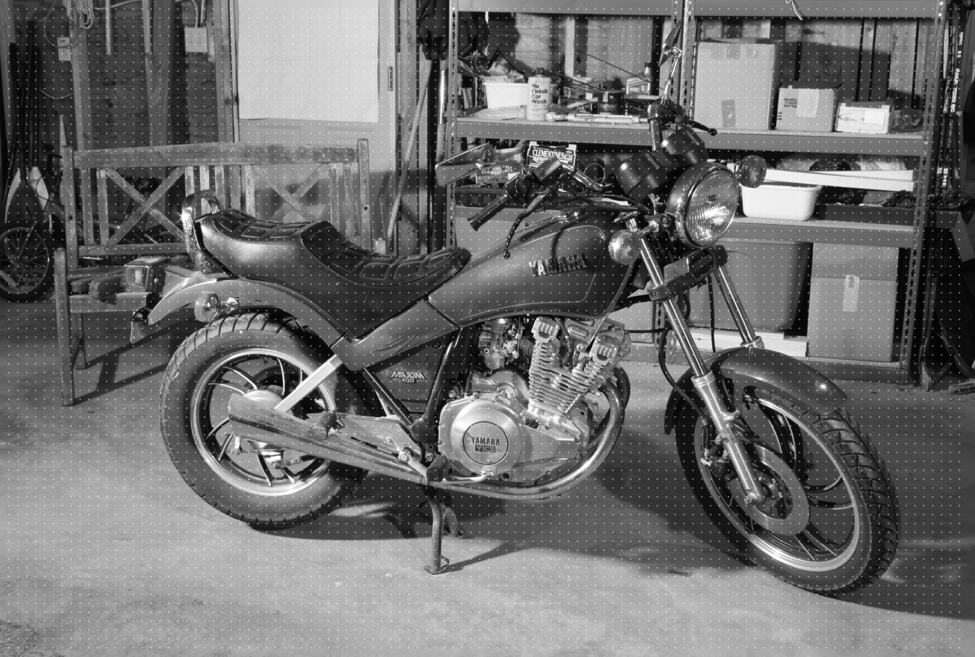

RESULTS AND DISCUSSION
DERIVATIVE BASED METHODS RESULTS
15
Initial left grayscale image with simulated grid overlapped
Disparity result obtained applying the derivative based designed algorithm

Slide 17
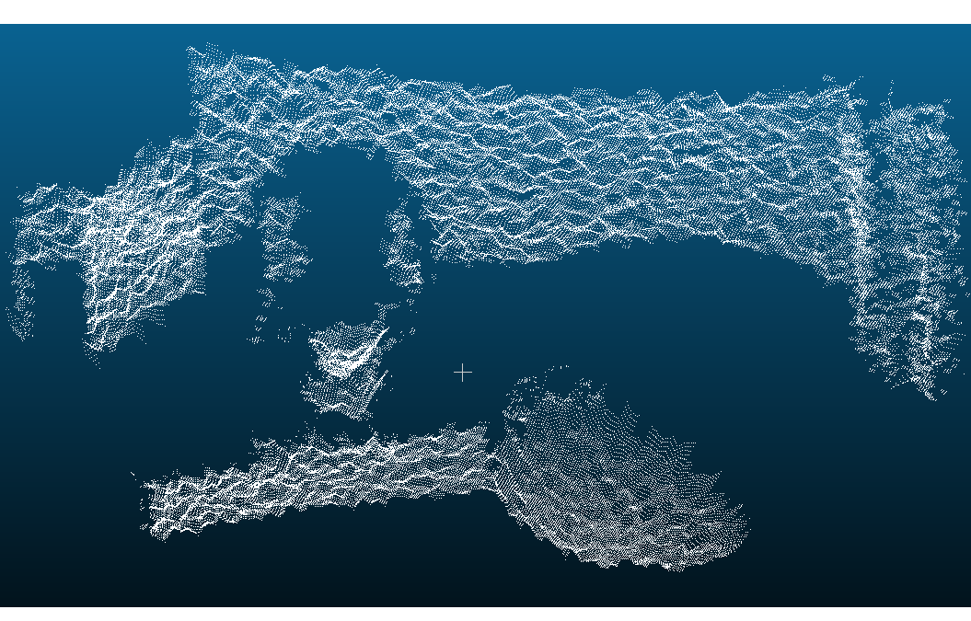
RESULTS AND DISCUSSION
DERIVATIVE METHOD RESULTS WITH REAL IMAGES
16
Left RGB micro left stereo image
Final denser point cloud

Slide 18
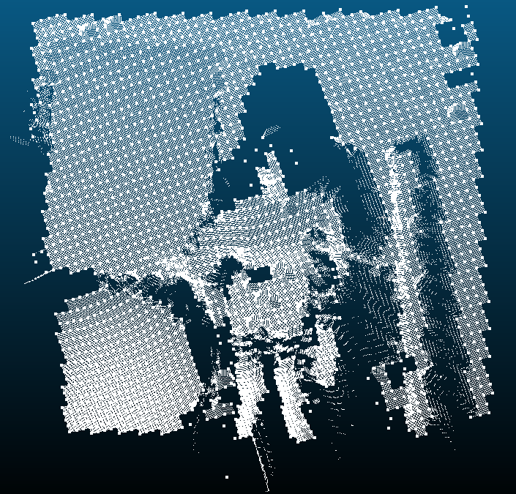
RESULTS AND DISCUSSION
DERIVATIVE METHOD RESULTS WITH REAL IMAGES
17
Left RGB 4-eye left stereo image
Final denser point cloud with initial cloud overlapped

Slide 19
RESULTS AND DISCUSSION
DISCUSSION AND IMPROVEMENT
18
Designed derivative based algorithm gives the best trade-off considering accuracy and computational cost
SGM based method appears to reach a high level of accuracy, however the execution time cannot theoretically provide a feasible real time application
In general the outcomes obtained seem promising for carrying out a real-time implementation of the algorithm, achieving an accurate dense point cloud of the analysed scene
Considering the overall project:
Further improvements should be provided to the code in order to guarantee a real-time execution
However, considering the linearity of the designed code, a potential real-time implementation can be assumed as certainly feasible by applying the derivative based algorithm
That algorithm can be then tuned thus to ensure different levels of accuracy
Further improvement aimed at enhance the densification for small objects will be developed

Slide 20
STRUCTURED LIGHT ASSISTED REAL-TIME STEREO PHOTOGRAMMETRY FOR ROBOTICS AND AUTOMATION
Novel implementation of stereo matching

